Slide 1
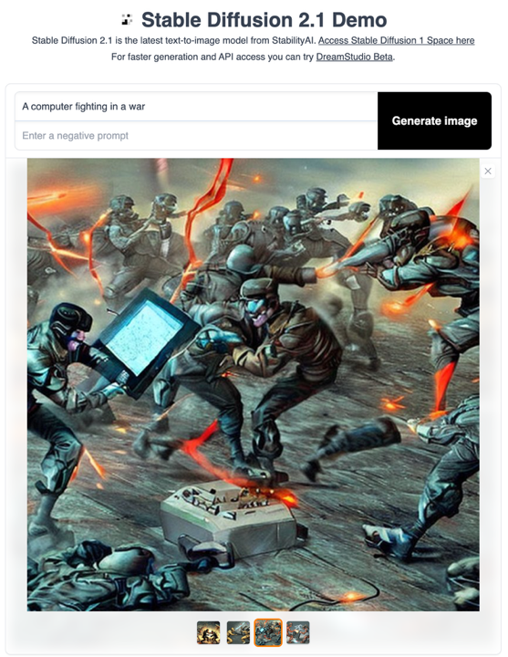
Deep Learning is Not Just for Text (or images) or Video by themselves
Scrape all of the images from the internet and their associated text/captions
Learn the relationship between text and images
Train a model to create new images that are aligned with particular captions

Slide 2
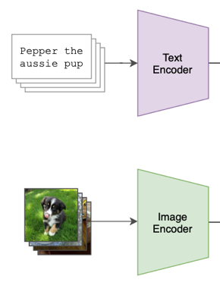
CLIP SPACE
CLIP (Contrastive Language Image Pre-Training), is the technical basis that allows current approaches to link images and text.
Trained on 5 billion pairs of (image, caption), CLIP has learned to embed images and related text to nearby locations (in a high-dimensional vector space).
This is surprisingly powerful.

Slide 3
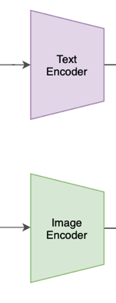
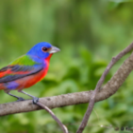
CLIP SPACE
Myrtle Warbler
“Orange Crowned Warbler”
Canada Warbler
Lazuli Bunting
Painted Bunting
“Painted Bunting”
This is surprisingly powerful. It also makes very quick, easy image classifiers

Slide 4
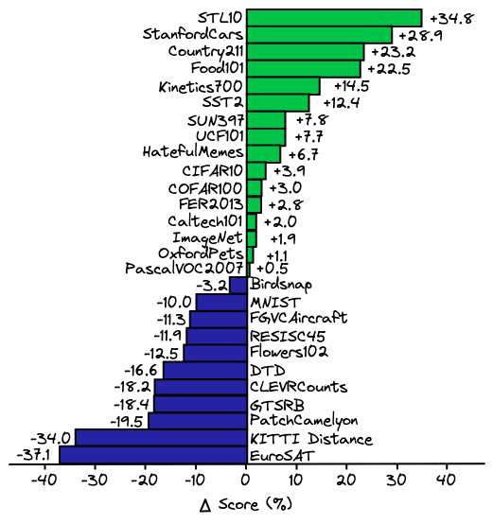
CLIP based classifiers outperform hand-tuned, specially trained classifiers for many, many datasets
If you have a problem for which you need image classification, you no longer need to talk to Computer Vision faculty. Now any good undergrad can make you a classifier for exactly the classes you care about.
…. But are they good?
This is surprisingly powerful. It also makes very quick, easy image classifiers

Slide 5
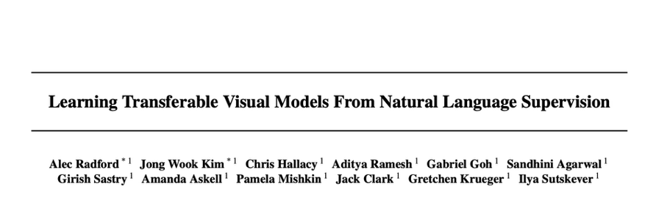
CLIP:
Contrastive Language
Image
Pre-training

Slide 6
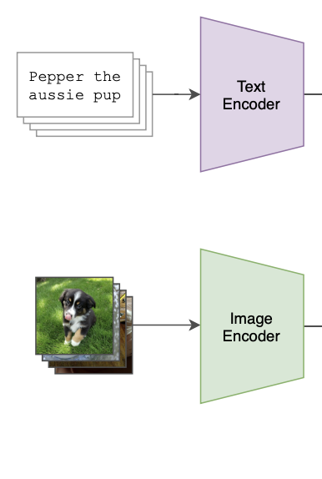
“Regular” Neural Network Training
Next word?
Correct Category?

Slide 7
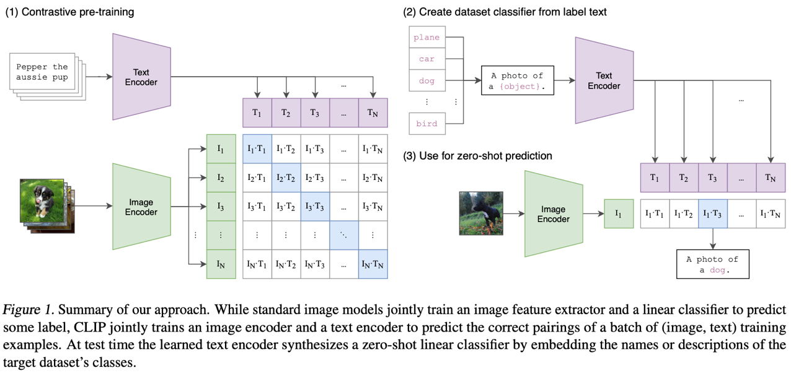

Slide 8
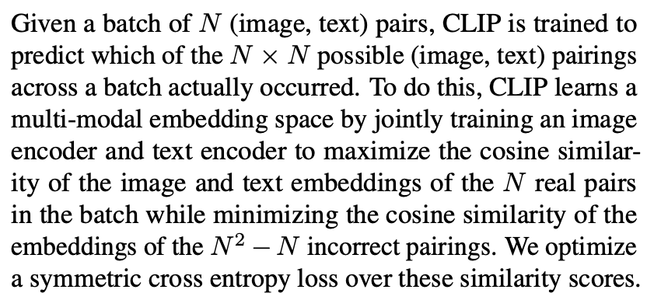

Slide 9
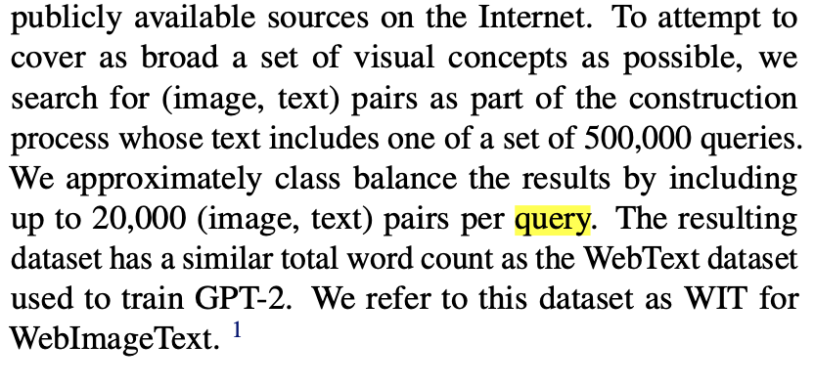
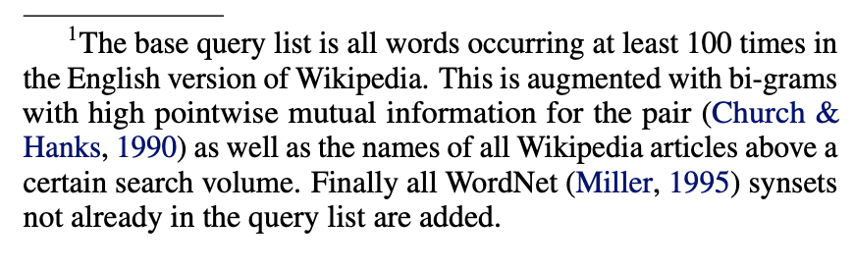

Slide 10
ML Background Questions:
“What is the SOTA algorithm?”
”What is one-shot learning?”
“What is few-shot learning?”
“What is zero-shot learning?”

Slide 12
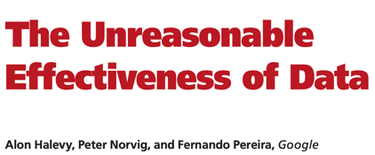
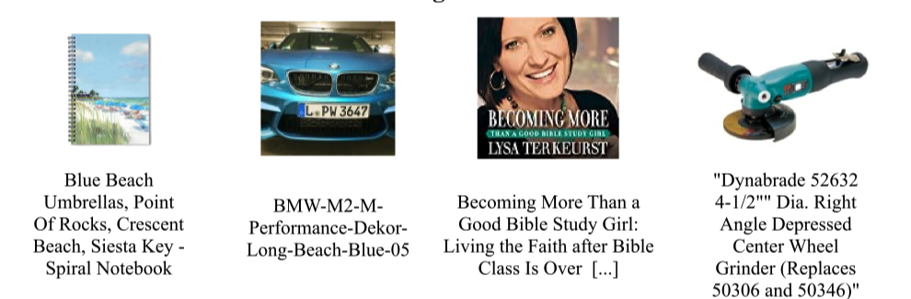
… even when your data is much less clean that you’d hope…
Example images + captions from the CLIP training data

Slide 13
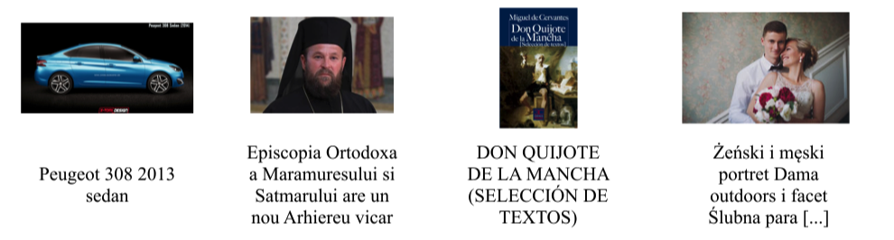
Example images + captions from the CLIP training data

Slide 14
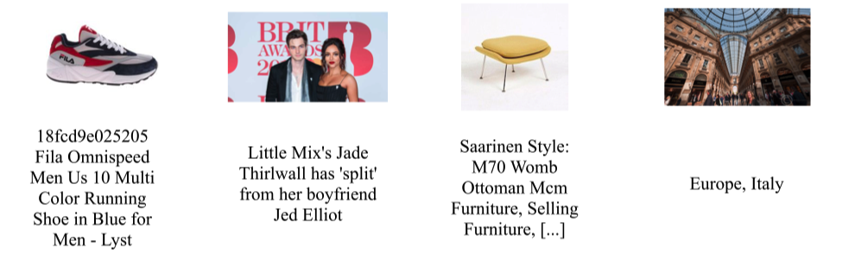
Example images + captions from the CLIP training data

Slide 15
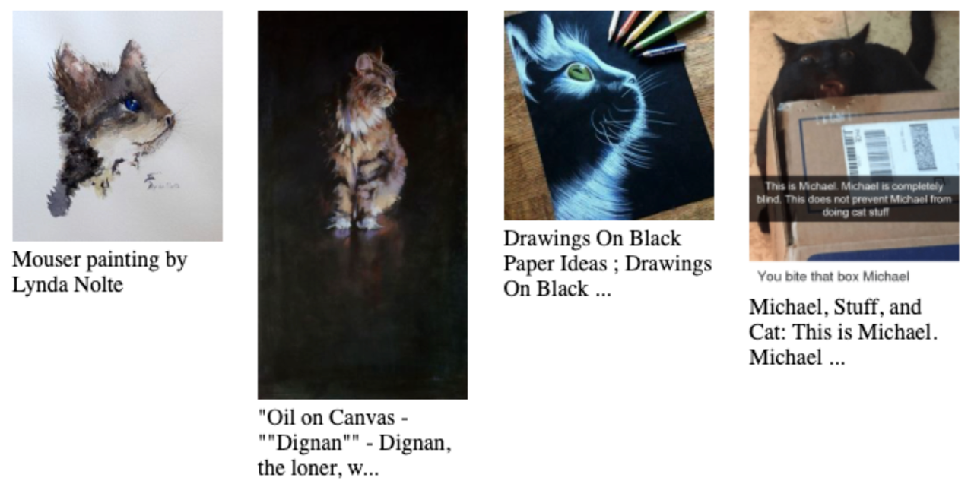
Example images + captions from the CLIP training data

Slide 16
CLIP SPACE
“Blue Cat”
Application 1: Query a large image dataset with arbitrary English

Slide 17
CLIP SPACE
“Blue Cat”
CLIP Features of all images in your database

Slide 18
CLIP SPACE
“Blue Cat”
CLIP Features of all images in your database
Retrieve nearby images as search results

Slide 19
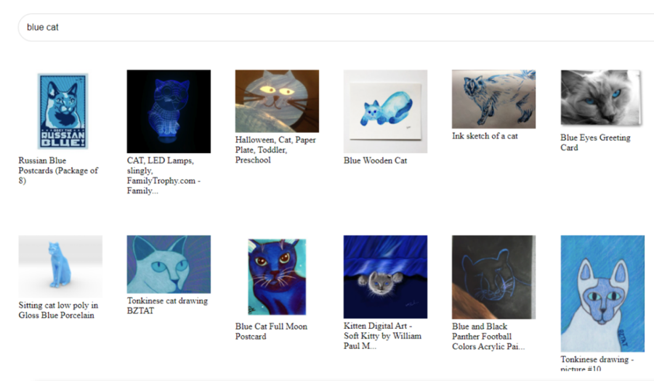
This allows generalizable image search for any feature you can name, even if that was not planned for when data was captured or stored.

Slide 20
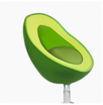
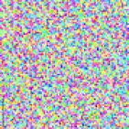
CLIP SPACE
“Avocado Chair”
Application 2: Dall-E. (“Generating images from Text”)
Your text is mapped into CLIP space to create an image target.
Then a random starting image is created and mapped into CLIP space.
Then gradient descent is used to update pixel values to change the image --- so that the CLIP embedding moves closer to the target

Slide 21
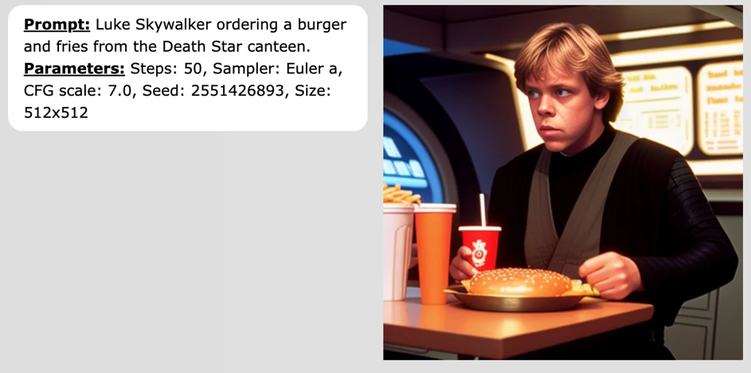

Shockingly Good

Slide 22
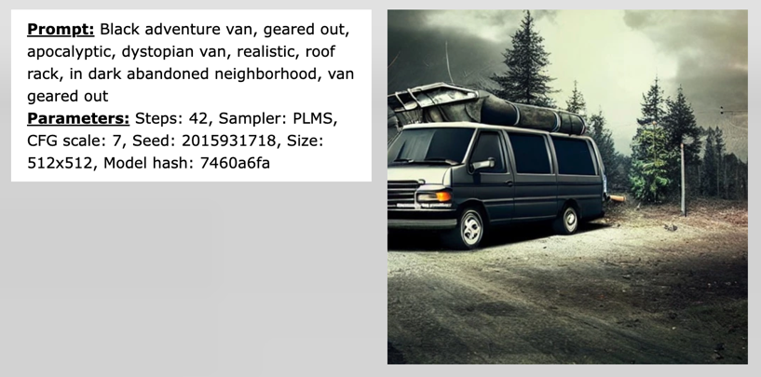

Shockingly Good

Slide 23
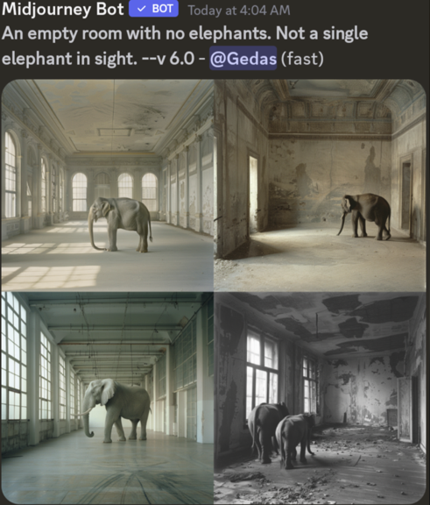
Shockingly Good (sometimes)
Why would this happen?
The CLIP model mapping text to images is trained with images and captions --- of all possible objects, what is most likely to be in an image with a caption that says “no elephant”?

